Slide 1


A wind tunnel for kids…
“In-Class” Demo
March 8, 2012

Slide 2
Introduction
Demo broken down by subsystems
Several in-class demos provided already using YouTube
New videos added to show current state

Slide 3
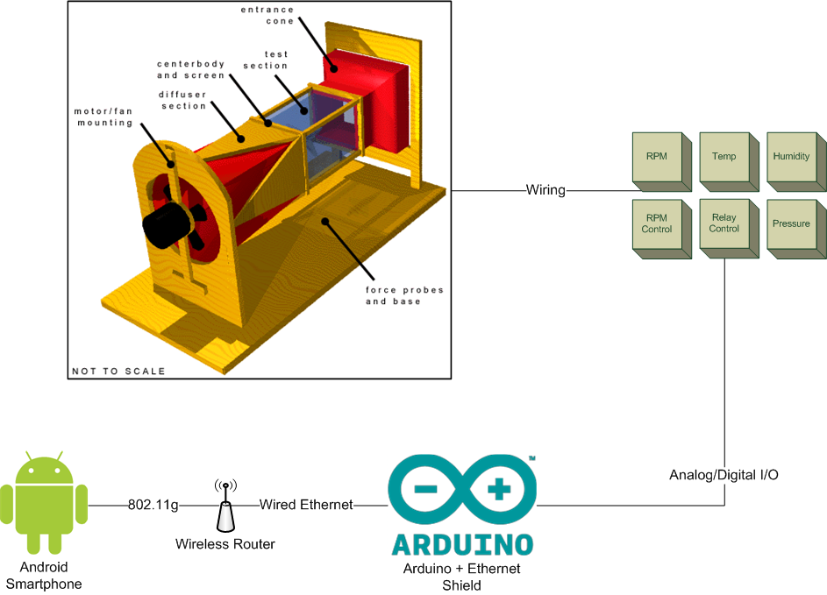
System Diagram

Slide 4
Android Subsystem

Slide 5
Android Subsystem
Trend Graph
http://youtu.be/HrSJLhGlStc
Human-Machine Interface (Controls UI)
http://youtu.be/ZqCDj0iIIuw

Slide 6
Arduino Subsystem

Slide 7
Arduino Subsystem
Arduino Communication Demo
http://youtu.be/ZX7wXZvURYY
Stepper Motor Changing Fan Speed (Arduino Controlled)
http://youtu.be/I_8lglANa6E
Hall Effect Sensor Demo
http://youtu.be/aW49hBf3XIw

Slide 8
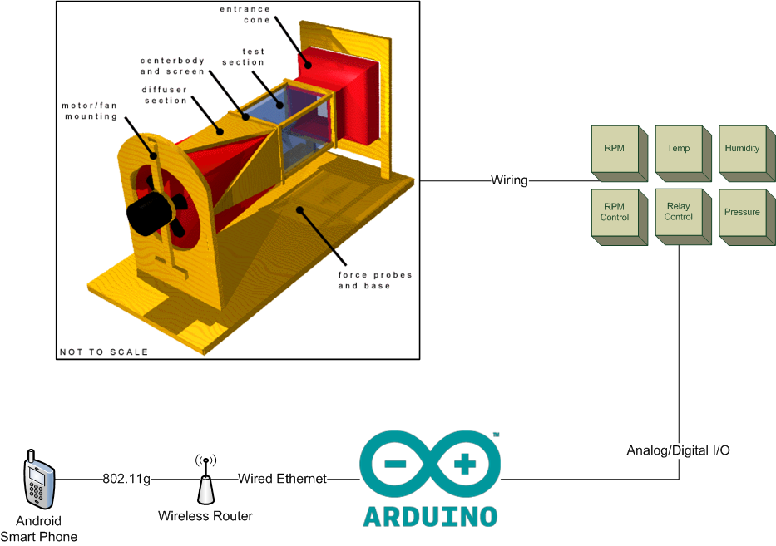
End-to-End

Slide 9
End-to-End
Android/Arduino Communication & Power Resilience
http://youtu.be/SK_XOnMkb-Q
Fan Control From Phone
http://youtu.be/rQQNqLvDWc0

Slide 10
For Your Viewing Pleasure…
Playlist containing all videos shown
http://www.youtube.com/playlist?list=PLFD79AE0FFAB2A2D9

Slide 11


Follow us on Twitter… 7 followers – 47 tweets
@TunnelK
Notes:
Initial social network of choice…

